Slide 1

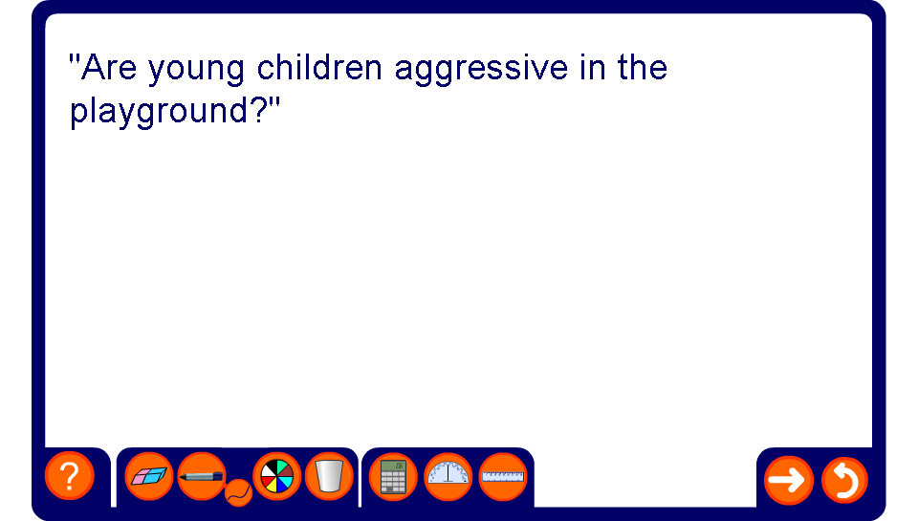


Improving hypotheses
Notes:
Click to bring up a badly formed hypothesis to discuss. Agree each time on a better one.

